Slide 1

AllSWell Health Mate Project
Health Management System
Team Members:
Ugochukwu Gabriel Ngene

Slide 2

Project Objectives
ALLSWELL HEALTH MATE
platform for patients to schedule appointments with listed doctors
SECURE ACCESS for patient HEALTH RECORDS. creation/update capability for doctors
data-driven decision-making based on health records.

Slide 3
Development Tools
Backend/API: C# ASP.NET, SQL
Frontend: Angular, Typescript
Version Control: GitHub
Initial Testing tools: SwaggerUI, NUnit

Slide 4
Version 1 Features
UI Design: Landing Page, Login Page, Appointments Workflow, Health Records Workflow
JWT Authenticated Login
Ability to view, update health records
Appointment Scheduling
JWT Token expiration for security

Slide 5
Version 2 Features
Data Analysis using AI and past records
Optimization for many users

Slide 6
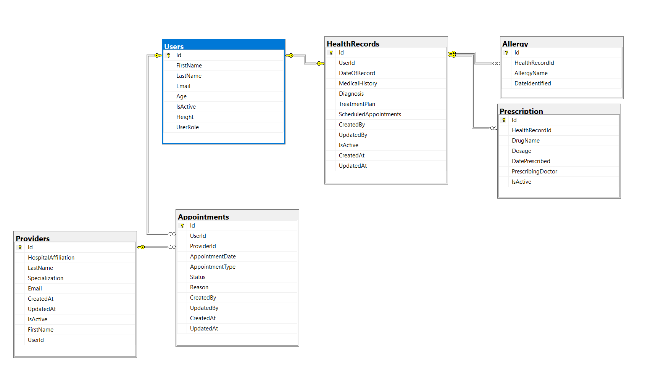

Database Schema
Tables:
Users
HealthRecords
Allergy
Prescription
Appointments
Providers

Slide 7
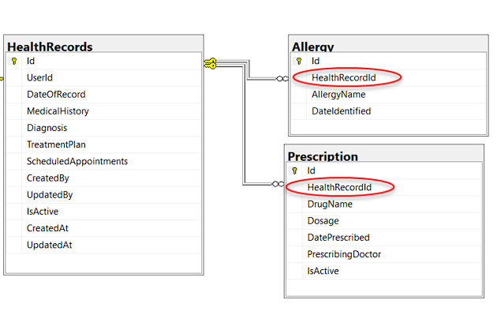
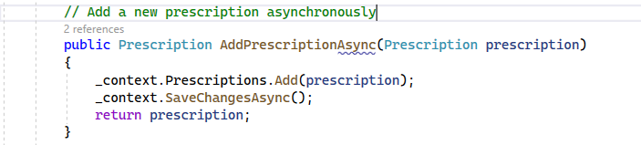
Risks and Mitigation
1. Synchronicity Issues: Multiple functions trying to access the same resource.
Mitigation: Implementation of multithreading functions of await, async and subscribe to ensure that one process finishes before a resource is accessed by another thread.

Slide 8
Risks and Mitigation
2. Security Issues: . Improper encryption of tokens, poor API security, or SQL breach could expose sensitive data.
Mitigation: More testing for SQL injection. Also ensure all sensitive data (e.g., passwords, tokens) are encrypted on database side and securely transmitted. JWT expiration set to 30 minutes.
Encrypted columns

Slide 9
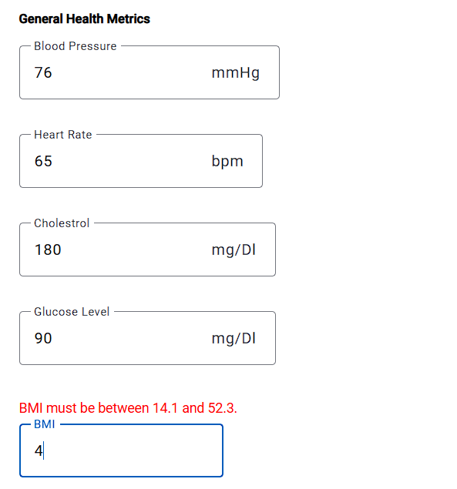
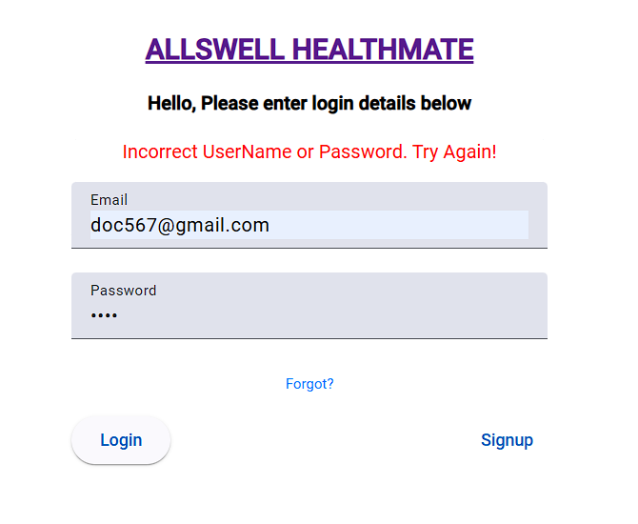
Risks and Mitigation
3. Data validation and form handling: : User input validation, especially on forms (like login, sign-up, creating health records), lead to invalid data being passed to the backend without proper validation on both sides.
Mitigation: Unit tests and functional tests were made to cover all form fields for valid, invalid, and missing data.
Health Record Form Validation
Login Validation
Error messages to stop invalid data on UI side

Slide 10
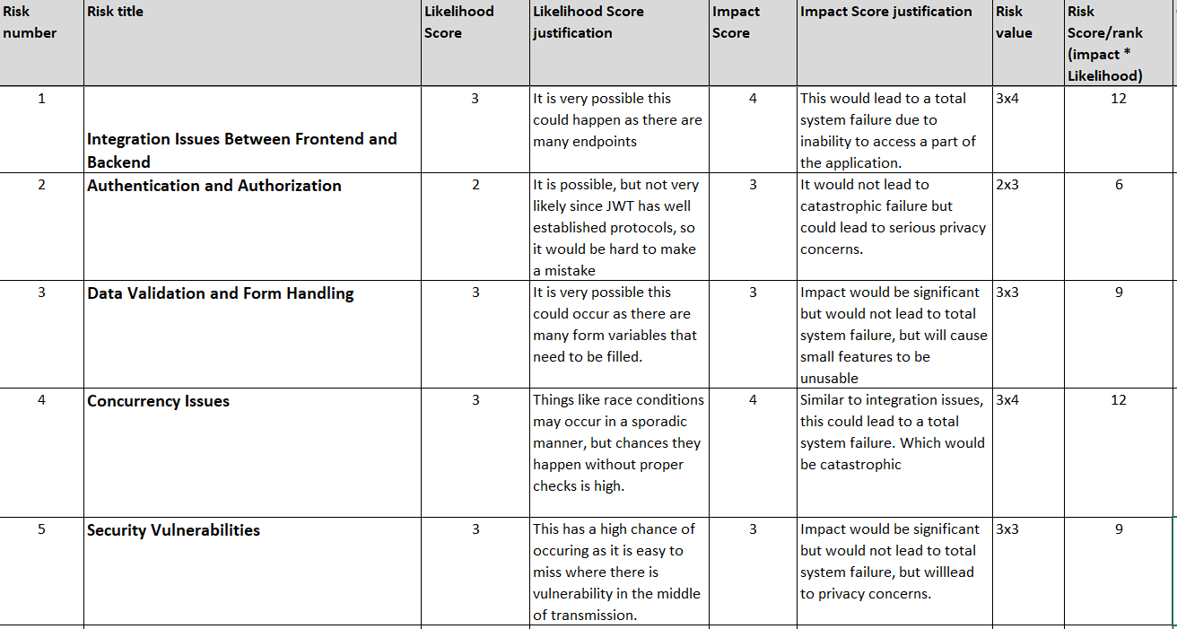
Risks and Mitigation
Full Risk Table with Likelihood x Impact

Slide 11
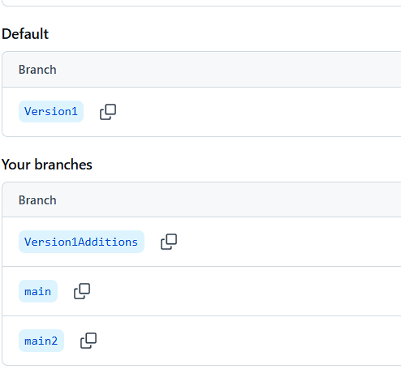
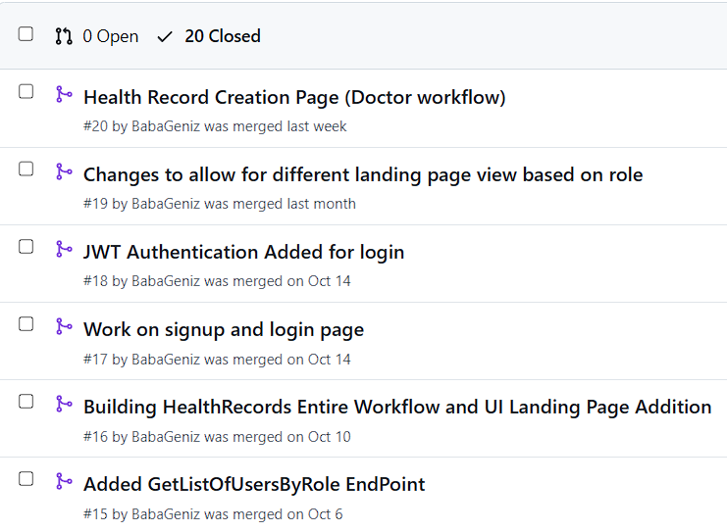
Configuration Management
Tool Choice:
GitHub as the main repository for version control and configuration tracking.
Version-Based Commit Strategy:
Committed changes incrementally, focusing on version-specific updates.
Allowed for systematic rollbacks and easier tracking of historical changes by version.
Version 1 used as default branch
Multiple pull requests with comments for easy rollback

Slide 12
System Testing Objectives
Authentication & Authorization:
Validate that users can securely log in and that only authorized users (doctors or patients) can access specific areas of the application.
Core Functionality:
Ensure that key user flows, such as creating, viewing, and updating health records, work as intended across all user roles.
User Experience and Responsiveness:
Validate that error messages, loading states, and data bindings work effectively to enhance usability.

Slide 13
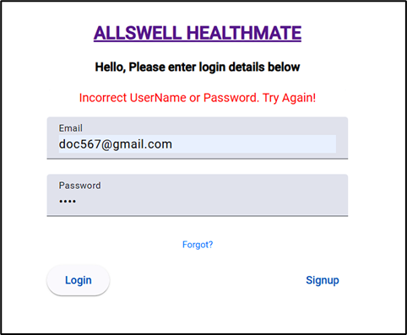

Security and Login Validation
Sensitive user info such as ID, email, password are encoded into JWT token and then decoded on UI side.
Invalid Input Result
Valid Input Result

Slide 14
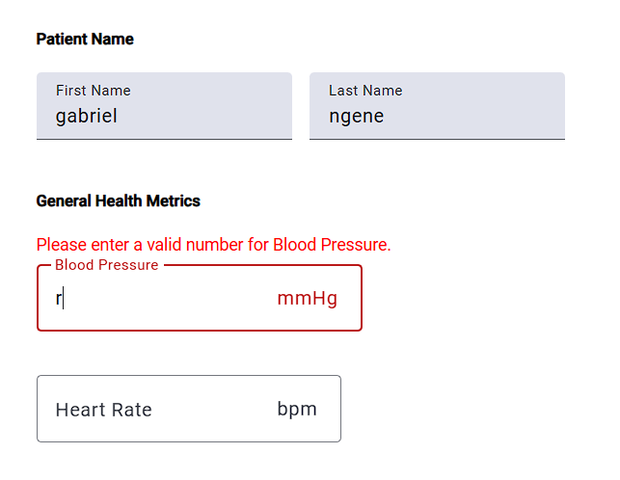
Health Record Form Validation
Invalid Range Validation
Invalid Character Validation

Slide 15
THANK YOU

